Slide 1
Stream Ciphers
process message bit by bit (as a stream)
have a pseudo random keystream
combined (XOR) with plaintext bit by bit
randomness of stream key completely destroys statistically properties in message
C_{i} = M_{i} XOR StreamKey_{i}
but must never reuse stream key
otherwise can recover messages

Slide 2
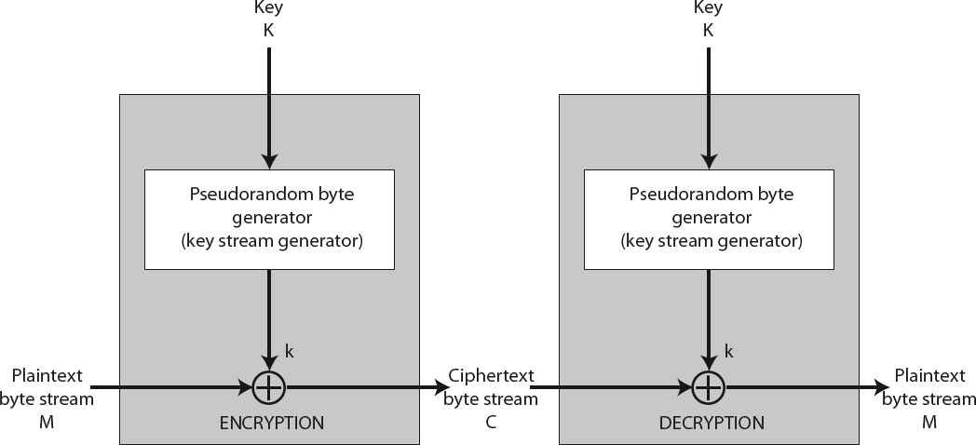
Stream Cipher Structure

Slide 3




Stream Cipher Properties
some design considerations are: long period with no repetitions statistically random
depends on large enough key large linear complexity
properly designed, can be as secure as a block cipher with same size key
but usually simpler & faster

Slide 4
RC4
Stream Cipher
Ron Rivest design, simple but effective variable key size, byte-oriented stream cipher widely used (web SSL/TLS, wireless WEP/WPA)
key forms random permutation of all 8-bit values
uses that permutation to scramble input information processed a byte at a time

Slide 5
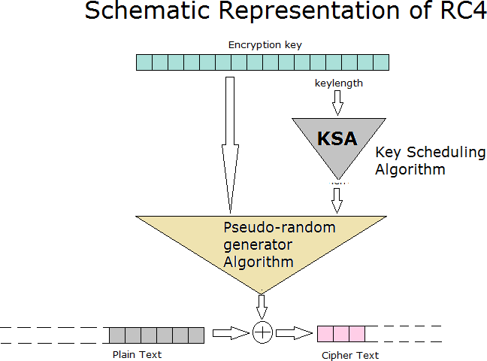

Slide 6
RC4 Key Schedule
starts with an array S of numbers: 0..255 A temporary vector T is also created
If the length of key K is 256 bytes ,then K is transferred to T
For a key of length ‘ keylen’ bytes, the first keylen elements of T are copied from K & then K is repeated as many times as necessary to fill out T.

Slide 7
Initialization
for i = 0 to 255 do
S[i] | = | i;
T[i] | = | K[i | mod | keylen];
Initial permutation of S
j = 0;
for i = 0 to 255 do
j = (j + S[i] + T[i]) (mod 256)
swap (S[i], S[j])

Slide 8
RC4 Encryption (1)
encryption continues shuffling array values
Stream Generation
i,j = 0;
While (true)
i = |  | (i + | 1) mod 256
j = |  | (j + | S[i]) mod 256
swap(S[i], S[j])
t | = | (S[i] + |  | S[j]) mod 256
K | = | S[t];

Slide 9
RC4 Encryption (2)
To encrypt , XOR the value k with the next byte of plain text.
To decrypt , XOR the value k with the next byte of cipher text

Slide 10
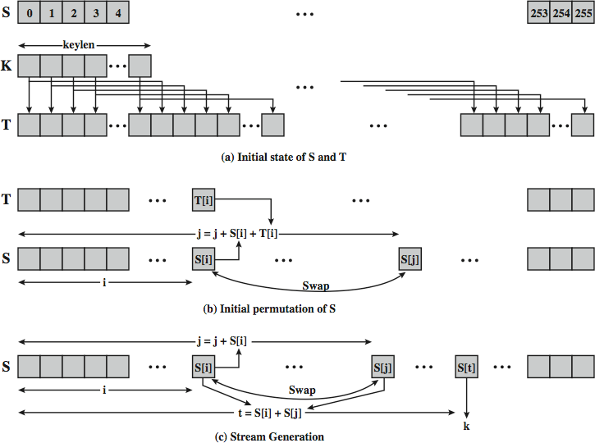
RC4 Overview

Slide 11
RC4 Security
claimed secure against known attacks
have some analysis, none practical
result is very non-linear
since RC4 is a stream cipher, must never reuse a key

Slide 12
RC4
Divided into 2 parts
Key Scheduling Algorithm (KSA)
Pseudo Random Generation Algorithm (PRGA)
Run PRGA on the KSA output to generate Key stream
XOR the data with key stream

Slide 13
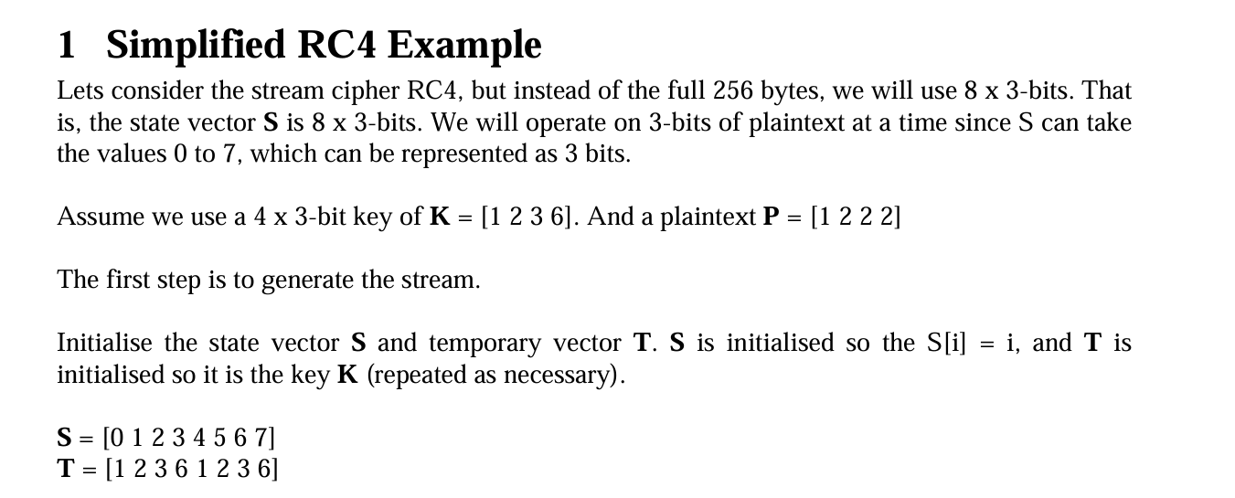

Slide 14
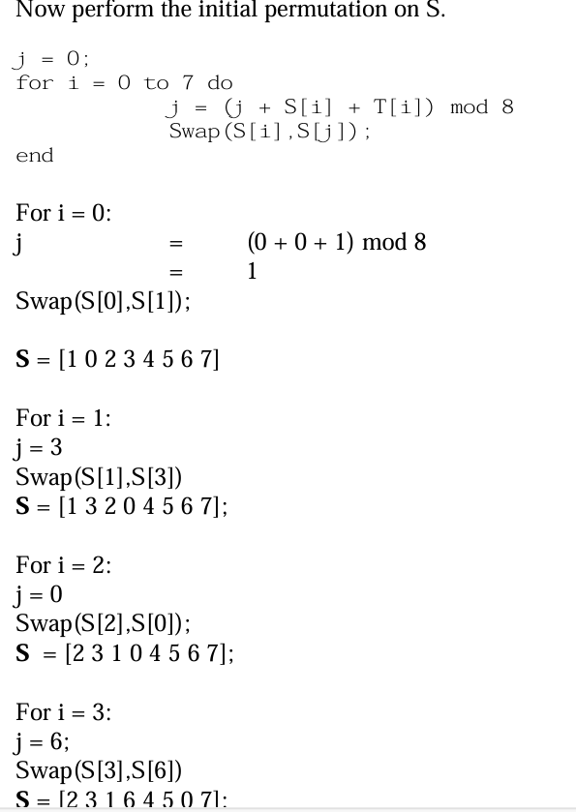

Slide 15
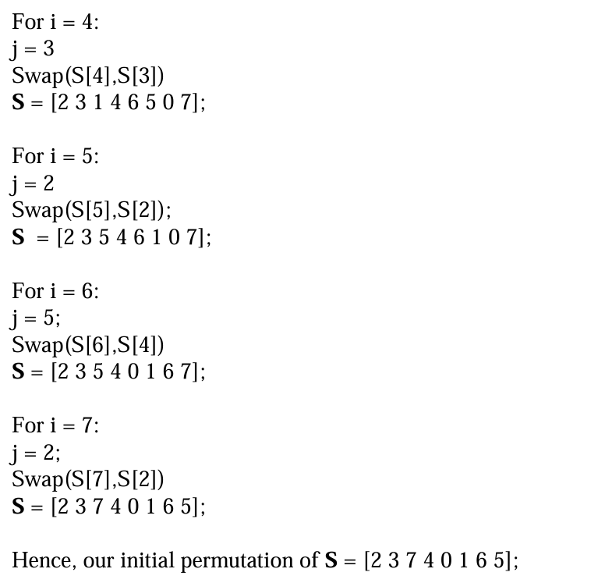

Slide 16
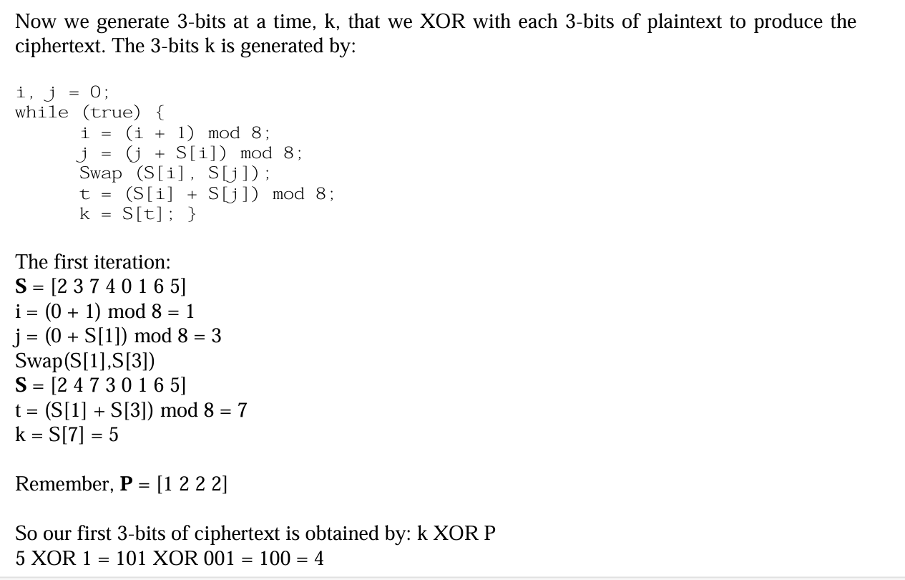

Slide 19
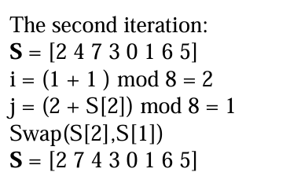
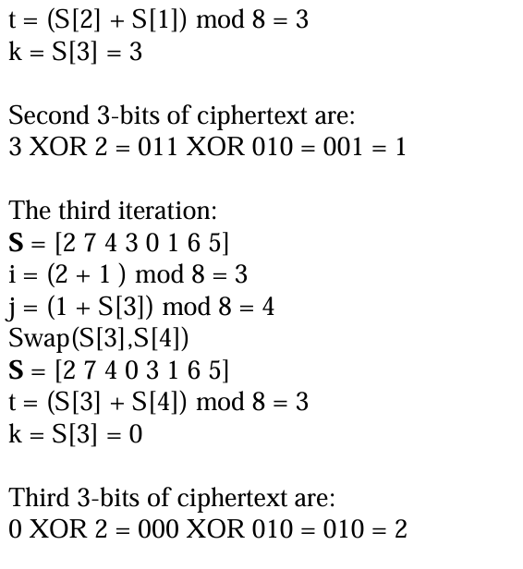

Slide 20
